Slide 1
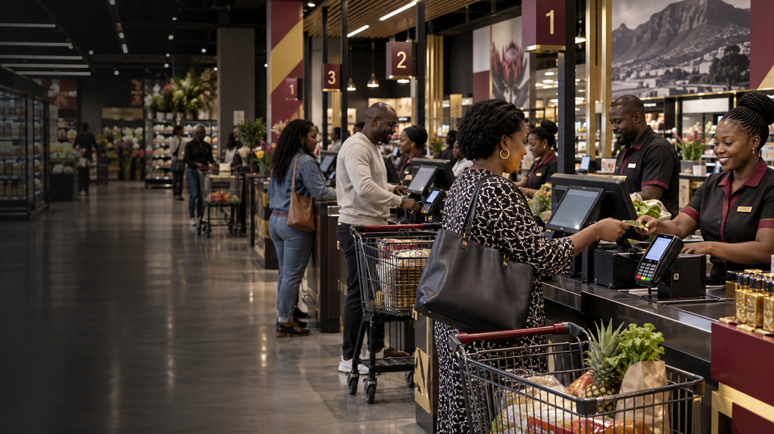


PRODUCT OVERVIEW · 2026
iVeri indiGo,
Integrated retail.
Integrate card payments into existing till systems and bring multi-lane retail activity into one view.
Sales Enablement · iVeri Payment Technologies
September 2026

Slide 2
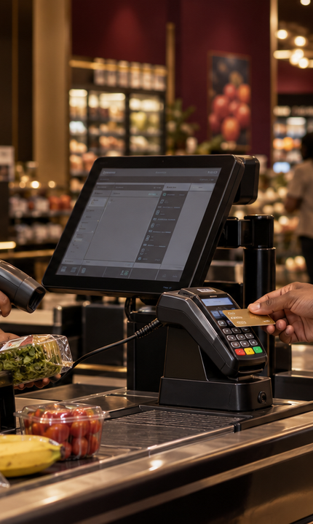


AGENDA
what we'll cover
01
What is indiGo?
02
Why merchants choose it
03
Core capabilities
04
indiGo at a glance
05
Integration workflow
06
Pitch and next steps
02 / 10

Slide 3
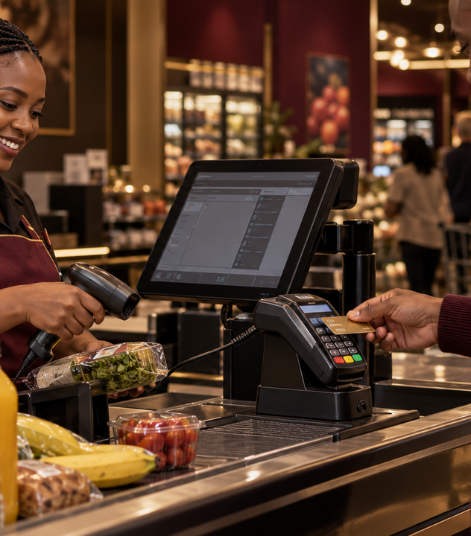
WHAT IS IVERI INDIGO?
Integrated payments for multi-lane retail.
EXISTING
TILL SYSTEM
iVeri indiGo integrates the payment module into a retailer’s existing till system.
MULTI-LANE
VISIBILITY
It supports a consolidated view of cash and card transactions across multiple lanes or stores, alongside inventory sales information.
“One integrated view across the retail operation.”
THE INDIGO VALUE
03 / 10
Notes:
Sources: https://www.iveri.com/sales-hub-indigo ; https://iys-ice.iveri.com/merchant-solutions/indigo/ (accessed 21 September 2026).

Slide 4

02
SECTION · 02
Why
indiGo
A strong fit for retailers that need integrated payments and a clearer view across tills, lanes or stores.

Slide 5
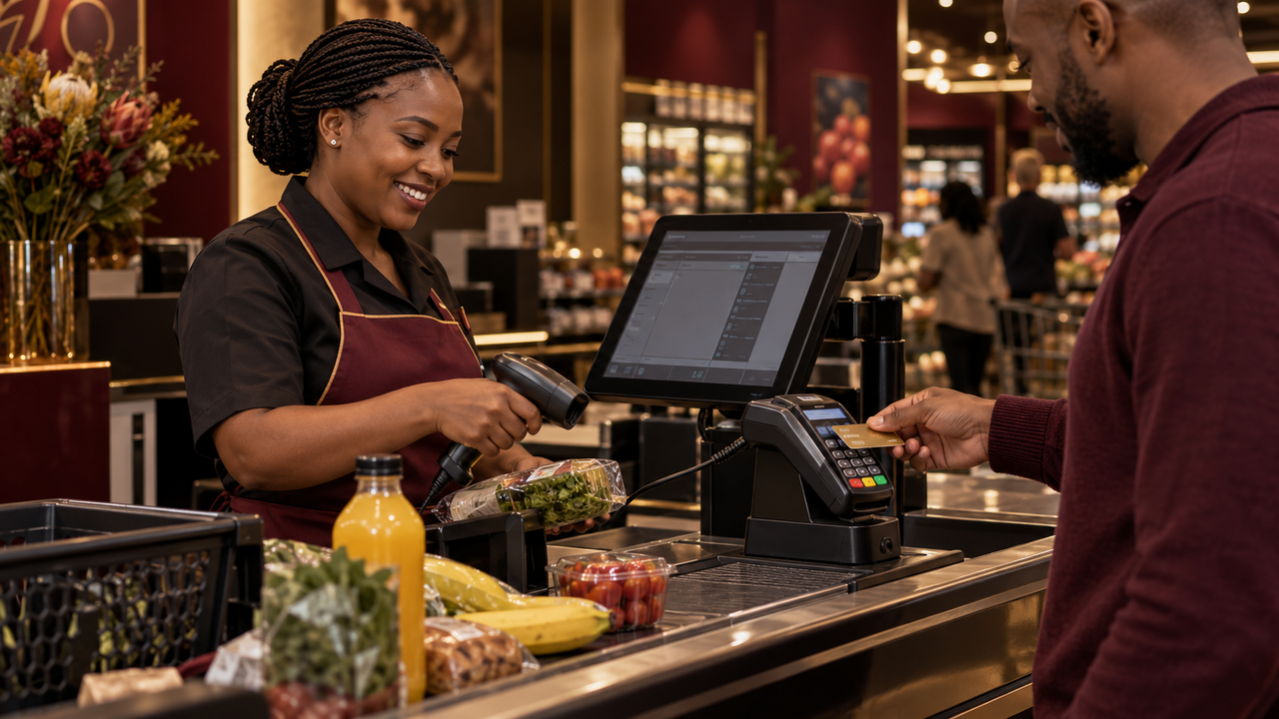
WHY MERCHANTS CHOOSE INDIGO
Payments connected to retail operations.
01
02
03
Till integration
Consolidated visibility
Retail management
Connect card payments to the retailer’s existing till system and established checkout process.
View cash and card transactions across multiple lanes or stores from a more unified position.
Bring payment activity and inventory sales closer together to simplify operational oversight.
05 / 10
Notes:
Sources: https://www.iveri.com/sales-hub-indigo ; https://iys-ice.iveri.com/merchant-solutions/indigo/ (accessed 21 September 2026).

Slide 6
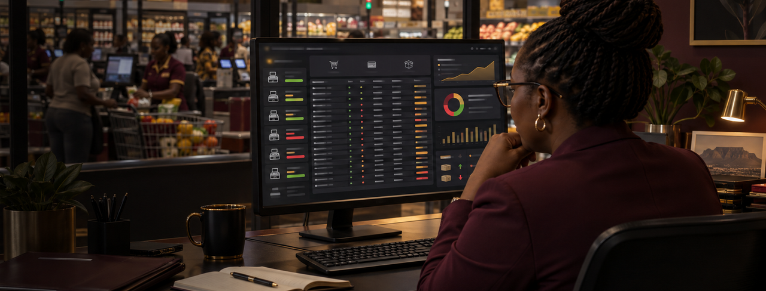
INDIGO AT A GLANCE
A connected model for multi-lane retail.
TILL
CARD
MULTI
ONE
SYSTEM
PAYMENTS
LANE
VIEW
existing retailer platform
integrated at checkout
and multi-store support
cash, card and inventory activity
06 / 10
Notes:
Sources: https://www.iveri.com/sales-hub-indigo ; https://iys-ice.iveri.com/merchant-solutions/indigo/ (accessed 21 September 2026).

Slide 7
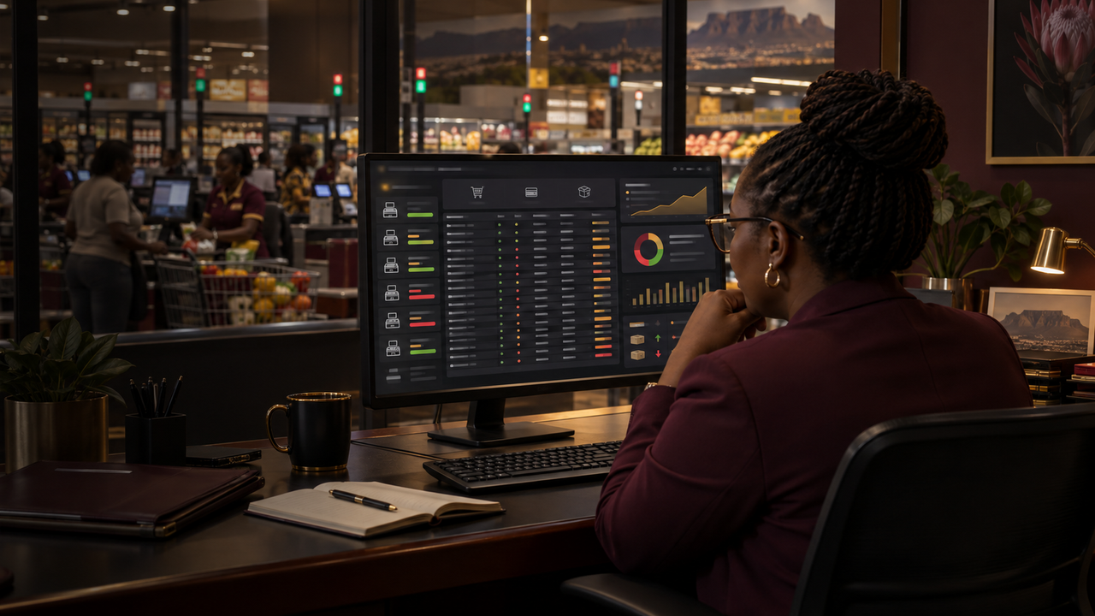

INDIGO INTEGRATION WORKFLOW
From till integration to consolidated oversight.
STEP 01
STEP 02
STEP 03
STEP 04
Assess environment
Integrate payments
Process at checkout
Consolidate activity
Confirm the till system, store structure, lane requirements and integration partner.
Connect the indiGo payment module to the existing till and checkout workflow.
Accept card payments through the integrated flow across the retailer’s lanes.
Use the combined retail view to monitor cash, card and inventory sales across the operation.
07 / 10
Notes:
Sources: https://www.iveri.com/sales-hub-indigo ; https://iys-ice.iveri.com/merchant-solutions/indigo/ (accessed 21 September 2026).

Slide 8



THE INDIGO SALES PITCH
The right fit, solution and value.
01
02
03
The right fit
The solution
The value
Multi-lane or multi-store retailers that want payments integrated into their current till environment.
indiGo integrates card processing into the till system and supports one view across lanes or stores.
A more unified view of cash, card and inventory sales, with added value for retailers, acquirers and integrators.
08 / 10
Notes:
Sources: https://www.iveri.com/sales-hub-indigo ; https://iys-ice.iveri.com/merchant-solutions/indigo/ (accessed 21 September 2026).

Slide 9
NEXT STEPS
A practical route from retail environment to rollout.
STEP 01
STEP 02
STEP 03
STEP 04
Discover
Plan integration
Configure & test
Pilot & rollout
Confirm the retailer’s till platform, number of stores and lanes, payment needs and reporting goals.
Align the retailer, acquirer and integrator on solution scope, responsibilities and rollout approach.
Configure the integrated payment flow, test at selected lanes and confirm operational visibility.
Pilot in a controlled store environment, review results and extend the solution across the agreed estate.
09 / 10
Notes:
Sources: https://www.iveri.com/sales-hub-indigo ; https://iys-ice.iveri.com/merchant-solutions/indigo/ (accessed 21 September 2026).

Slide 10
indiGo Sales
indiGo connects card payments to existing till systems for clearer multi-lane retail visibility.
EMAIL
sales@iveri.com
PHONE
+27 11 269 4000
WEB
www.iveri.com
iVeri · payment technology

