Slide 1



PRODUCT OVERVIEW · 2026
Tap on Phone,
Card acceptance.
Accept contactless card payments on a compatible Android smartphone through the iVeri mPress app.
Sales Enablement · iVeri Payment Technologies
September 2026

Slide 2
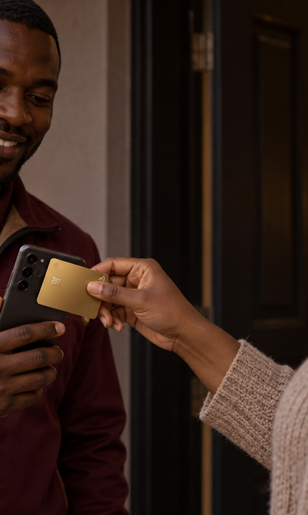


AGENDA
what we'll cover
01
What is Tap on Phone?
02
Why merchants choose it
03
Core capabilities
04
Tap on Phone at a glance
05
Payment workflow
06
Pitch and next steps
02 / 10

Slide 3
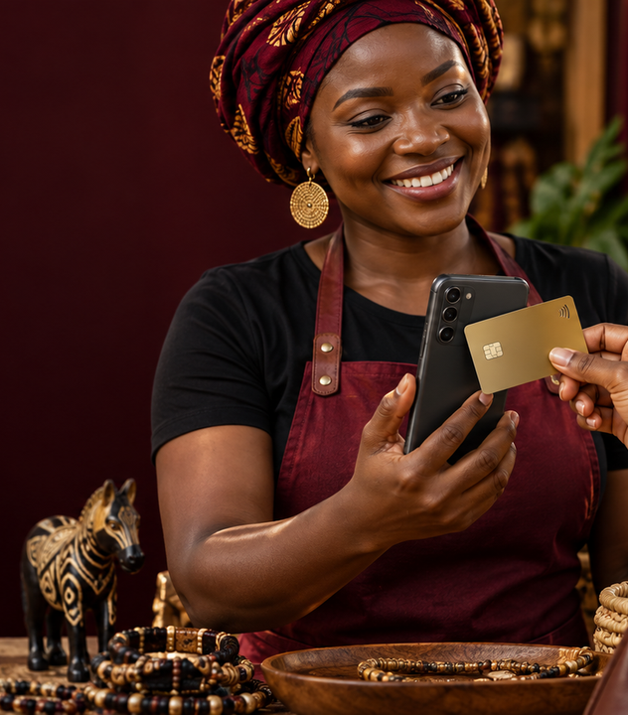
WHAT IS TAP ON PHONE?
Contactless acceptance through a smartphone.
NO
CARD MACHINE
Tap on Phone is a payment feature in the iVeri mPress app that turns a compatible Android NFC smartphone into a contactless acceptance device.
ANDROID
SMARTPHONE
Merchants enter the amount, select Tap on Phone and ask the customer to tap a contactless card on the back of the phone.
“Accept payments wherever business happens.”
THE TAP ON PHONE VALUE
03 / 10
Notes:
Sources: https://www.iveri.com/sales-hub-tap-on-phone ; https://iys-ice.iveri.com/merchant-solutions/mpress/ ; https://www.iveri.co.za/tap-on-phone (accessed 21 September 2026).

Slide 4
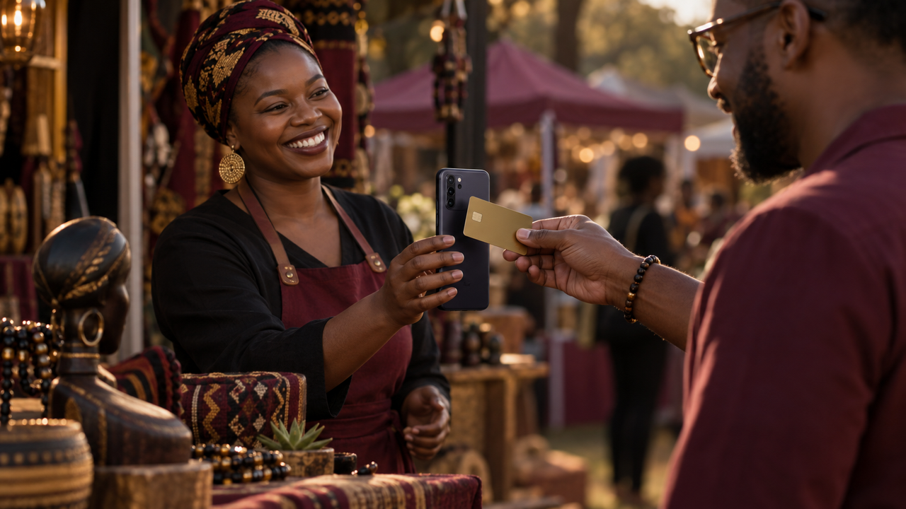
02
SECTION · 02
Why
Tap on Phone
A practical fit for mobile businesses that want to accept contactless card payments without a separate card machine.

Slide 5
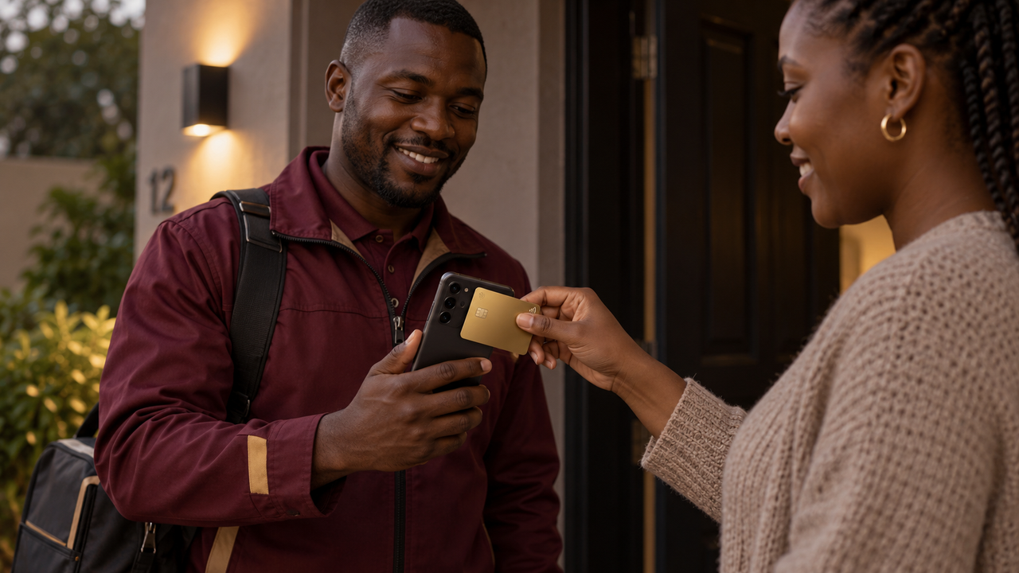
WHY MERCHANTS CHOOSE TAP ON PHONE
Contactless payments through a phone.
01
02
03
Lower equipment cost
Mobile acceptance
Simple transaction flow
Accept contactless cards without purchasing or carrying a separate card machine.
Take payments on the go wherever the merchant has a compatible Android smartphone.
Enter the amount, select Tap on Phone and let the customer tap and enter a PIN when prompted.
05 / 10
Notes:
Sources: https://www.iveri.com/sales-hub-tap-on-phone ; https://iys-ice.iveri.com/merchant-solutions/mpress/ ; https://www.iveri.co.za/tap-on-phone (accessed 21 September 2026).

Slide 6

TAP ON PHONE AT A GLANCE
A phone-based route to card acceptance.
PHONE
NFC
CARD
DIGITAL
READY
ENABLED
TAP
RECORD
Android 8.0 or later
compatible smartphone
on the back of the phone
transaction captured securely
06 / 10
Notes:
Sources: https://www.iveri.com/sales-hub-tap-on-phone ; https://iys-ice.iveri.com/merchant-solutions/mpress/ ; https://www.iveri.co.za/tap-on-phone (accessed 21 September 2026).

Slide 7

TAP ON PHONE PAYMENT WORKFLOW
From app setup to recorded payment.
STEP 01
STEP 02
STEP 03
STEP 04
Prepare the phone
Open mPress
Tap the card
Confirm payment
Use a Google-compatible, NFC-enabled smartphone running Android 8.0 or later.
Download or update the mPress app, activate the merchant and enter the transaction amount.
Select Tap on Phone and ask the customer to tap their contactless card on the back of the phone.
The customer enters a PIN when prompted, then the app confirms and records the transaction.
07 / 10
Notes:
Sources: https://www.iveri.com/sales-hub-tap-on-phone ; https://iys-ice.iveri.com/merchant-solutions/mpress/ ; https://www.iveri.co.za/tap-on-phone (accessed 21 September 2026).

Slide 8



THE TAP ON PHONE SALES PITCH
The right fit, solution and value.
01
02
03
The right fit
The solution
The value
Mobile merchants and service businesses that need card acceptance without a separate card machine.
The mPress app enables contactless payments on a compatible Android NFC smartphone.
Lower equipment costs, mobile payment acceptance and recorded transactions through the mPress app.
08 / 10
Notes:
Sources: https://www.iveri.com/sales-hub-tap-on-phone ; https://iys-ice.iveri.com/merchant-solutions/mpress/ ; https://www.iveri.co.za/tap-on-phone (accessed 21 September 2026).

Slide 9
NEXT STEPS
A practical route from merchant need to first payment.
STEP 01
STEP 02
STEP 03
STEP 04
Discover
Check compatibility
Activate & test
Launch
Confirm the merchant’s business model, payment volumes, locations and need for mobile acceptance.
Confirm the Android version, Google compatibility, NFC capability and connectivity.
Complete merchant activation, install the latest mPress app and run a controlled test transaction.
Start accepting payments and confirm transaction records, customer receipts and ongoing support.
09 / 10
Notes:
Sources: https://www.iveri.com/sales-hub-tap-on-phone ; https://iys-ice.iveri.com/merchant-solutions/mpress/ ; https://www.iveri.co.za/tap-on-phone (accessed 21 September 2026).

Slide 10
Tap on Phone
Tap on Phone helps merchants accept contactless card payments through a compatible Android smartphone.
EMAIL
sales@iveri.com
PHONE
+27 11 269 4000
WEB
www.iveri.com
iVeri · payment technology

