Slide 1



PRODUCT OVERVIEW · 2026
iVeri Batch,
Volume payments.
Process regular card-payment collections in secure batches, on the date the merchant chooses.
Sales Enablement · iVeri Payment Technologies
September 2026

Slide 2
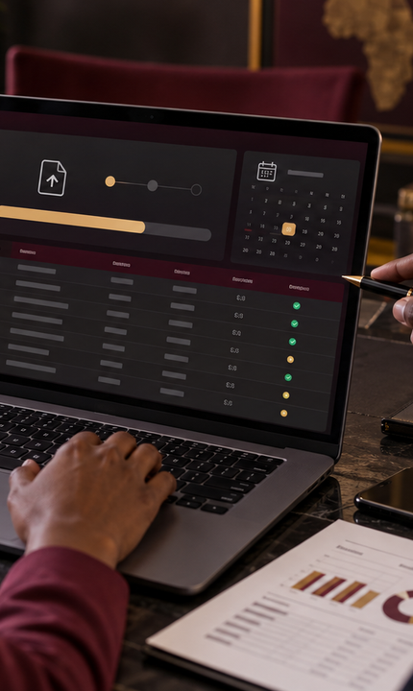


AGENDA
what we'll cover
01
What is Batch?
02
Why merchants choose it
03
Core capabilities
04
Batch at a glance
05
Batch workflow
06
Pitch and next steps
02 / 10

Slide 3

WHAT IS IVERI BATCH?
Regular collections, processed together.
YOUR
PROCESSING DATE
iVeri Batch is designed for merchants that accept cards but do not need to process every transaction in real time.
CLEAR
BATCH STATUS
Merchants upload a file in the required format or create a batch manually in BackOffice, then schedule it for secure gateway processing.
“Prepare once. Process the collection together.”
THE BATCH VALUE
03 / 10
Notes:
Sources: https://www.iveri.com/sales-hub-batch ; https://iys-ice.iveri.com/merchant-solutions/batch/ (accessed 21 September 2026).

Slide 4

02
SECTION · 02
Why
Batch
A practical fit for scheduled card collections that do not need immediate transaction processing.

Slide 5

WHY MERCHANTS CHOOSE BATCH
Control regular payment collections.
01
02
03
Scheduled processing
Flexible batch creation
Visibility & reconciliation
Choose the date on which the batch runs, including a future date for month-end or non-working days.
Upload a file in the required format or use BackOffice to create the batch for secure gateway processing.
Review batch status, use transaction reports and reconcile in the accounting system with the completed batch file.
05 / 10
Notes:
Sources: https://www.iveri.com/sales-hub-batch ; https://iys-ice.iveri.com/merchant-solutions/batch/ (accessed 21 September 2026).

Slide 6
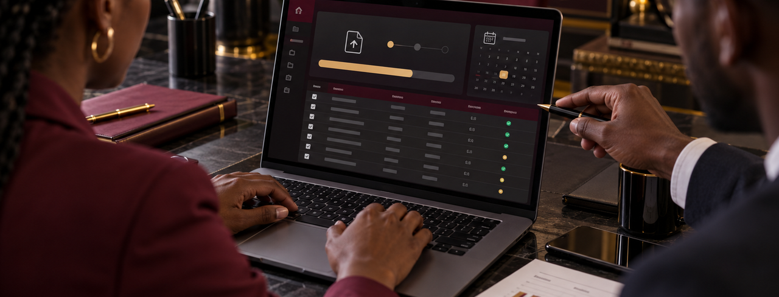
BATCH AT A GLANCE
Operational control for scheduled collections.
FILE
CREATE
SET
VIEW
UPLOAD
BATCH
DATE
STATUS
in the required format
manually in BackOffice
for future processing
after processing
06 / 10
Notes:
Sources: https://www.iveri.com/sales-hub-batch ; https://iys-ice.iveri.com/merchant-solutions/batch/ (accessed 21 September 2026).

Slide 7

BATCH PROCESSING WORKFLOW
From payment file to reconciliation.
STEP 01
STEP 02
STEP 03
STEP 04
Prepare batch
Choose date
Upload & process
Review & reconcile
Create the payment file in the required format or build the batch manually in BackOffice.
Select when the batch should run, including a future processing date when required.
Upload the batch securely to the iVeri Payment Gateway for transaction processing.
Check the batch status in BackOffice and reconcile using the completed batch file.
07 / 10
Notes:
Sources: https://www.iveri.com/sales-hub-batch ; https://iys-ice.iveri.com/merchant-solutions/batch/ (accessed 21 September 2026).

Slide 8



THE BATCH SALES PITCH
The right fit, solution and value.
01
02
03
The right fit
The solution
The value
Merchants that collect card payments regularly and do not need every transaction processed in real time.
Create or upload a payment batch, select the processing date and submit it securely through iVeri.
Scheduled processing, batch-status visibility and a completed result file for accounting reconciliation.
08 / 10
Notes:
Sources: https://www.iveri.com/sales-hub-batch ; https://iys-ice.iveri.com/merchant-solutions/batch/ (accessed 21 September 2026).

Slide 9
NEXT STEPS
A practical route from collection need to go-live.
STEP 01
STEP 02
STEP 03
STEP 04
Discover
Choose method
Prepare & test
Launch
Confirm the collection cycle, transaction volumes, processing dates and accounting requirements.
Decide whether the merchant will upload formatted files or create batches manually in BackOffice.
Set up file creation, secure upload, future-date scheduling and test-batch processing.
Go live, monitor batch status and confirm reporting, reconciliation and ongoing support.
09 / 10
Notes:
Sources: https://www.iveri.com/sales-hub-batch ; https://iys-ice.iveri.com/merchant-solutions/batch/ (accessed 21 September 2026).

Slide 10

Batch Sales
Batch suits merchants that collect card payments together and do not need real-time processing.
EMAIL
sales@iveri.com
PHONE
+27 11 269 4000
WEB
www.iveri.com
iVeri · payment technology

