Slide 1



PRODUCT OVERVIEW · 2026
iVeri SynXis,
Booking payments.
Enable secure guest payments inside the Sabre SynXis booking flow through onboarding and setup.
Sales Enablement · iVeri Payment Technologies
September 2026

Slide 2
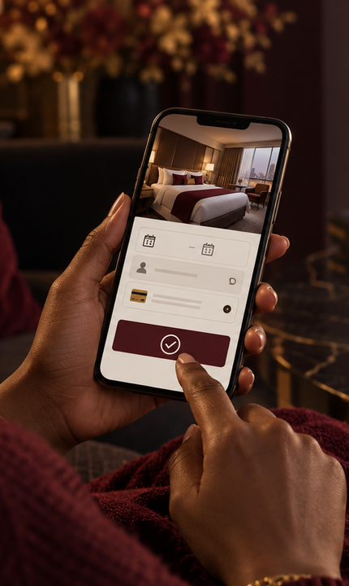


AGENDA
what we'll cover
01
What is SynXis?
02
Why hotels choose it
03
Core capabilities
04
SynXis at a glance
05
Enablement workflow
06
Pitch and next steps
02 / 10

Slide 3

WHAT IS THE IVERI SYNXIS INTEGRATION?
Payment acceptance inside the booking flow.
NO
HOTEL BUILD
Sabre SynXis is a cloud-based hotel booking engine. iVeri’s integration enables guests to pay securely when they make a reservation.
SECURE
BOOKING FLOW
Payments flow from SynXis to the iVeri Gateway after onboarding and setup, with no technical integration required on the hotel’s side.
“Live through onboarding, without a hotel-side build.”
THE SYNXIS VALUE
03 / 10
Notes:
Source: https://www.iveri.com/sales-hub-synxis (accessed 21 September 2026).

Slide 4

02
SECTION · 02
Why
SynXis
A strong fit for hotels already using Sabre SynXis that need guests to pay securely when they book.

Slide 5

WHY HOTELS CHOOSE SYNXIS
Payments enabled through onboarding.
01
02
03
No technical integration
Secure booking payments
Centralised reporting
Onboarding and setup enable payments, so the hotel does not need to build or maintain an integration.
Payments travel over a secure channel from the SynXis booking engine to the iVeri Gateway.
BackOffice provides one place to search, reconcile and report across hotel properties.
05 / 10
Notes:
Source: https://www.iveri.com/sales-hub-synxis (accessed 21 September 2026).

Slide 6

SYNXIS AT A GLANCE
Ready-made payment acceptance for hotels.
NO
3-D
MULTI
BACK
CODE
SECURE
PROPERTY
OFFICE
hotel-side development
optional authentication
onboarding and reporting
search, reconcile and report
06 / 10
Notes:
Source: https://www.iveri.com/sales-hub-synxis (accessed 21 September 2026).

Slide 7


SYNXIS ENABLEMENT WORKFLOW
From hotel qualification to booking payments.
STEP 01
STEP 02
STEP 03
STEP 04
Confirm the fit
Onboard properties
Enable payments
Launch & report
Confirm that the hotel uses Sabre SynXis and needs secure payment acceptance at reservation.
Complete merchant onboarding and configure each hotel property that needs payment acceptance.
Activate the SynXis-to-iVeri payment flow and add optional 3-D Secure where required.
Guests pay during booking while hotel teams use BackOffice to search, reconcile and report.
07 / 10
Notes:
Source: https://www.iveri.com/sales-hub-synxis (accessed 21 September 2026).

Slide 8



THE SYNXIS SALES PITCH
The right fit, solution and value.
01
02
03
The right fit
The solution
The value
Hotels using Sabre SynXis that need secure guest payment at reservation without a development project.
Onboarding and setup activate the ready-made payment flow from SynXis to the iVeri Gateway.
Secure booking payments, optional 3-D Secure and central reporting across multiple properties.
08 / 10
Notes:
Source: https://www.iveri.com/sales-hub-synxis (accessed 21 September 2026).

Slide 9
NEXT STEPS
A practical route from SynXis user to payment acceptance.
STEP 01
STEP 02
STEP 03
STEP 04
Discover
Define setup
Activate & test
Launch
Confirm current SynXis use, how booking payments work today and how many properties need onboarding.
Agree the merchant structure, property list, acquiring setup, 3-D Secure choice and reporting needs.
Complete onboarding, enable the payment flow and run controlled reservation-payment tests.
Start accepting payments and confirm BackOffice access, reconciliation and ongoing support.
09 / 10
Notes:
Source: https://www.iveri.com/sales-hub-synxis (accessed 21 September 2026).

Slide 10
SynXis Sales
The iVeri SynXis integration enables secure booking payments through onboarding, with no hotel-side build.
EMAIL
sales@iveri.com
PHONE
+27 11 269 4000
WEB
www.iveri.com
iVeri · payment technology

