Slide 1
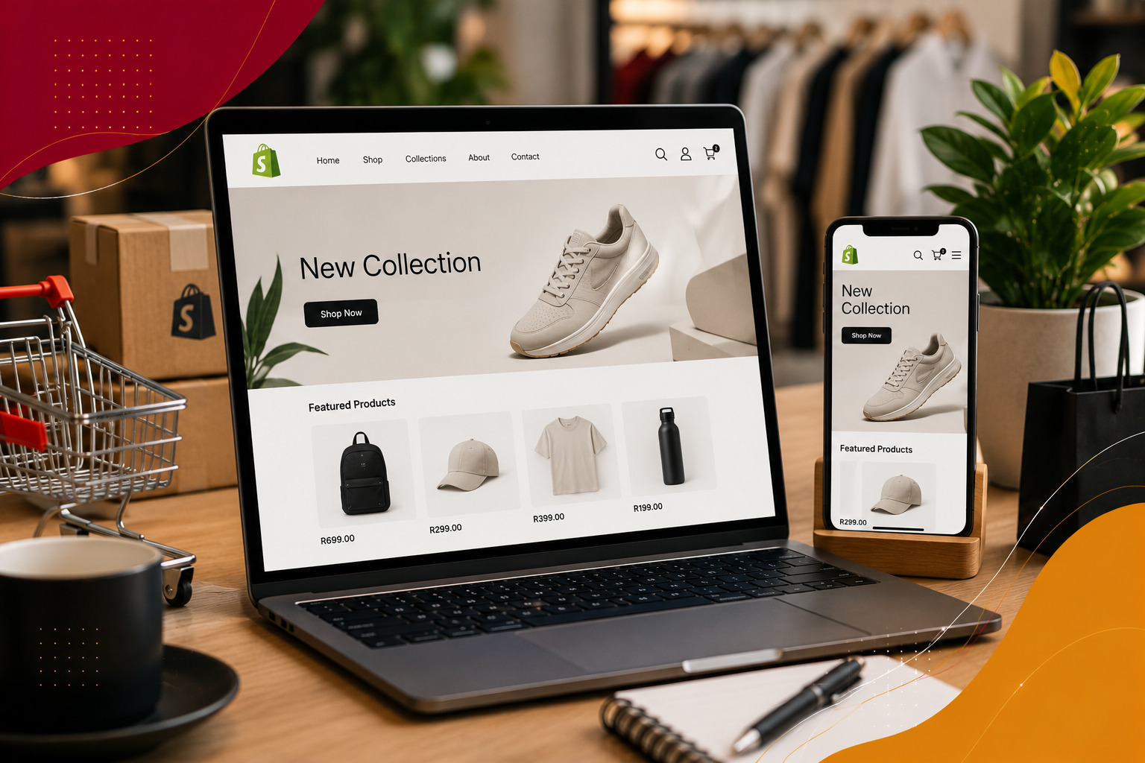


PRODUCT OVERVIEW · 2026
iVeri Lite,
simplified.
A secure hosted payment page that helps merchants start accepting online card payments quickly.
Sales Enablement · iVeri Payment Technologies

Slide 2



AGENDA
what we'll cover
01
What is Lite?
02
Why merchants choose it
03
Core capabilities
04
Integration options
05
Customer payment journey
06
Pitch and next steps
02 / 10

Slide 3

WHAT IS IVERI LITE?
Online payments, made simple.
LOW
INTEGRATION EFFORT
iVeri Lite is a hosted payment page for card-not-present transactions. At checkout, the customer is redirected to a secure page hosted by iVeri to enter their payment details.
FAST
ROUTE TO MARKET
It requires very little integration and is well suited to internet merchants with limited technical resources—helping them reduce development effort and get to market faster.
“Secure payments. Simpler setup.”
THE LITE VALUE
03 / 10
Notes:
Sources: https://www.iveri.com/sales-hub-lite ; https://www.iveri.co.za/e-commerce-1 ; https://iys-ice.iveri.com/merchant-solutions/lite/ (accessed 21 September 2026).

Slide 4

02
SECTION · 02
Why
Lite
A strong fit for merchants that want secure online payments without a complex integration.

Slide 5




WHY MERCHANTS CHOOSE LITE
Simple to launch. Secure by design.
01
02
03
Faster go-to-market
Security & compliance
Branded customer experience
Minimal technical complexity helps merchants integrate sooner and begin accepting online payments faster.
Card data is entered on iVeri's secure hosted page, helping reduce the merchant's PCI DSS scope. Optional 3D Secure adds authentication.
Merchants can configure logos, page inputs and email settings in BackOffice so checkout better reflects their brand.
05 / 10
Notes:
Sources: https://www.iveri.com/sales-hub-lite ; https://www.iveri.co.za/e-commerce-1 ; https://iys-ice.iveri.com/merchant-solutions/lite/ (accessed 21 September 2026).

Slide 6

LITE AT A GLANCE
Designed to remove payment complexity.
3
LOW
PCI
FULL
WAYS
EFFORT
SCOPE
CONTROL
to integrate Lite
minimal integration
helped to reduce
through BackOffice
06 / 10
Notes:
Sources: https://www.iveri.com/sales-hub-lite ; https://www.iveri.co.za/e-commerce-1 ; https://iys-ice.iveri.com/merchant-solutions/lite/ (accessed 21 September 2026).

Slide 7


CUSTOMER PAYMENT JOURNEY
From checkout to confirmation.
STEP 01
STEP 02
STEP 03
STEP 04
Start checkout
Open secure page
Enter details
Return to merchant
The customer confirms their basket and selects card payment on the merchant website.
Lite opens as a Full Redirect, LiteBox pop-up, or supported shopping-cart plugin.
The customer securely enters card details on the iVeri-hosted payment page.
After processing, the customer returns to the merchant website with the transaction result.
07 / 10
Notes:
Sources: https://www.iveri.com/sales-hub-lite ; https://www.iveri.co.za/e-commerce-1 ; https://iys-ice.iveri.com/merchant-solutions/lite/ (accessed 21 September 2026).

Slide 8



THE LITE SALES PITCH
The right fit, solution and value.
01
02
03
The right fit
The solution
The value
Online merchants that want a quick, low-complexity way to accept card payments.
A hosted payment page delivered through Full Redirect, LiteBox or a supported shopping-cart plugin.
Faster launch, reduced PCI DSS scope, optional 3D Secure and a checkout that reflects the merchant's brand.
08 / 10
Notes:
Sources: https://www.iveri.com/sales-hub-lite ; https://www.iveri.co.za/e-commerce-1 ; https://iys-ice.iveri.com/merchant-solutions/lite/ (accessed 21 September 2026).

Slide 9

NEXT STEPS
A practical route from fit to go-live.
STEP 01
STEP 02
STEP 03
STEP 04
Discover
Choose approach
Configure
Launch
Confirm the website platform, technical resources, payment methods and desired checkout experience.
Select Full Redirect, LiteBox or a supported shopping-cart plugin for the merchant's environment.
Set up BackOffice, payment-page branding, email settings, required inputs and 3D Secure.
Complete integration and testing, go live, then confirm transaction reporting and support.
09 / 10
Notes:
Sources: https://www.iveri.com/sales-hub-lite ; https://www.iveri.co.za/e-commerce-1 ; https://iys-ice.iveri.com/merchant-solutions/lite/ (accessed 21 September 2026).

Slide 10

Let's Sell Lite
Lead with speed, security and simplicity, then match the integration option to the merchant.
EMAIL
sales@iveri.com
PHONE
+27 11 269 4000
WEB
www.iveri.com
iVeri · payment technology

