Slide 1
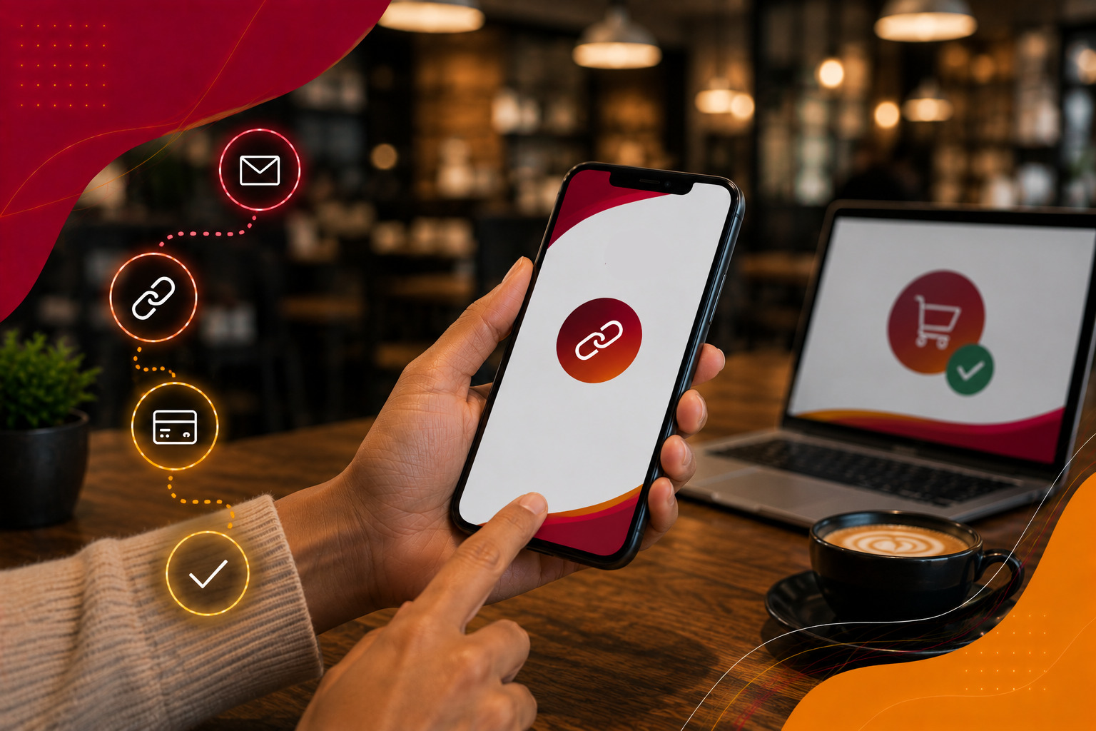


PRODUCT OVERVIEW · 2026
iVeri DiVert,
Pay by Link.
Request secure remote card payments with a personalised link, even without a website.
Sales Enablement · iVeri Payment Technologies
September 2026

Slide 2



AGENDA
what we'll cover
01
What is DiVert?
02
Why merchants choose it
03
Core capabilities
04
DiVert at a glance
05
Payment journey
06
Pitch and next steps
02 / 10

Slide 3

WHAT IS IVERI DIVERT?
Remote payments without a website.
NO
WEBSITE REQUIRED
iVeri DiVert lets merchants create personalised payment links for remote card transactions. They can share each link by email, SMS or a messaging platform.
ANY
DEVICE OR LOCATION
The customer opens a secure one-time payment page, completes the transaction on any device, and receives the result together with the merchant.
“Send a link. Receive the payment.”
THE DIVERT VALUE
03 / 10
Notes:
Sources: https://www.iveri.com/sales-hub-divert ; https://iys-ice.iveri.com/merchant-solutions/payment-link/ ; https://www.iveri.co.za/pay-by-link (accessed 21 September 2026).

Slide 4
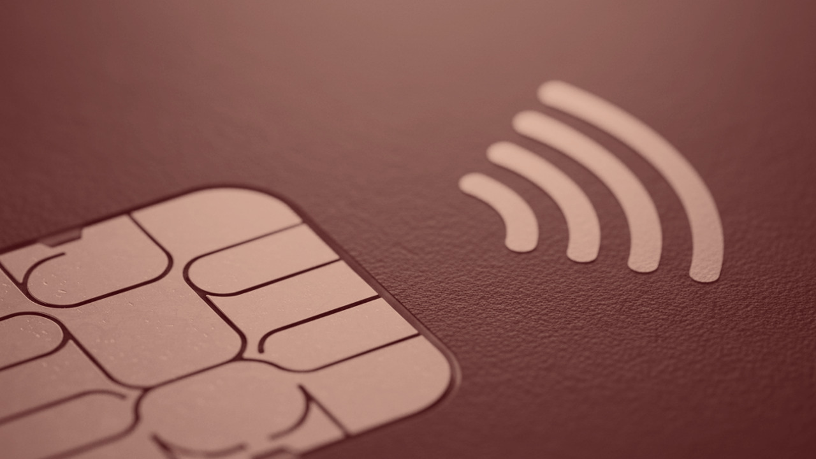
02
SECTION · 02
Why
DiVert
A practical option for remote sales and collections when the merchant does not have an online checkout.

Slide 5




WHY MERCHANTS CHOOSE DIVERT
Remote payments made easier.
01
02
03
Faster payment requests
Security & compliance
Flexible, personal requests
Create and send a payment request immediately, giving customers a simple route to complete the transaction.
Customers enter card details on a secure hosted page. DiVert helps reduce merchant PCI DSS scope and can include 3D Secure.
Add the customer's details, amount and reference. Attach an invoice when needed and set how long the request remains valid.
05 / 10
Notes:
Sources: https://www.iveri.com/sales-hub-divert ; https://iys-ice.iveri.com/merchant-solutions/payment-link/ ; https://www.iveri.co.za/pay-by-link (accessed 21 September 2026).

Slide 6
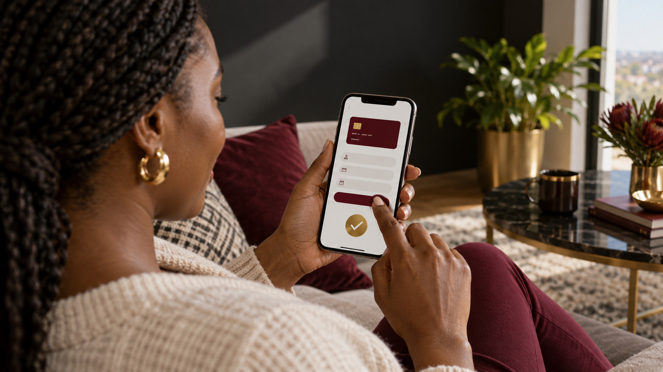
DIVERT AT A GLANCE
Useful controls for remote payments.
1
FLEX
ADD
BOTH
LINK
VALIDITY
INVOICE
NOTIFIED
to request payment
control the deadline
when required
merchant and customer
06 / 10
Notes:
Sources: https://www.iveri.com/sales-hub-divert ; https://iys-ice.iveri.com/merchant-solutions/payment-link/ ; https://www.iveri.co.za/pay-by-link (accessed 21 September 2026).

Slide 7



DIVERT PAYMENT JOURNEY
From request to confirmation.
STEP 01
STEP 02
STEP 03
STEP 04
Create request
Share the link
Customer pays
Confirm result
Enter the customer details, amount and merchant reference. Add an invoice or validity period if needed.
Send the personalised payment link by email, SMS or the customer's preferred messaging channel.
The link opens a secure one-time payment page where the customer enters their card details.
DiVert sends the transaction result to both the merchant and the customer by email.
07 / 10
Notes:
Sources: https://www.iveri.com/sales-hub-divert ; https://iys-ice.iveri.com/merchant-solutions/payment-link/ ; https://www.iveri.co.za/pay-by-link (accessed 21 September 2026).

Slide 8



THE DIVERT SALES PITCH
The right fit, solution and value.
01
02
03
The right fit
The solution
The value
Remote sales and collections where the merchant needs to request payment without a website checkout.
A personalised link sent by email, SMS or messaging channels opens a secure one-time payment page.
Flexible validity periods, optional invoice attachment, reduced PCI DSS scope and payment-result confirmations.
08 / 10
Notes:
Sources: https://www.iveri.com/sales-hub-divert ; https://iys-ice.iveri.com/merchant-solutions/payment-link/ ; https://www.iveri.co.za/pay-by-link (accessed 21 September 2026).

Slide 9
NEXT STEPS
A practical route from use case to go-live.
STEP 01
STEP 02
STEP 03
STEP 04
Discover
Configure
Prepare workflow
Launch
Confirm the payment use case, request volumes, communication channels, invoice needs and validity rules.
Set up merchant access, request details, branding, validity defaults and optional 3D Secure.
Define how staff create, send and track links, and how customers receive payment requests.
Test the full journey, brief staff and customers, go live, then confirm reporting and support.
09 / 10
Notes:
Sources: https://www.iveri.com/sales-hub-divert ; https://iys-ice.iveri.com/merchant-solutions/payment-link/ ; https://www.iveri.co.za/pay-by-link (accessed 21 September 2026).

Slide 10

Let's Sell DiVert
DiVert lets merchants request secure remote payments without a website.
EMAIL
sales@iveri.com
PHONE
+27 11 269 4000
WEB
www.iveri.com
iVeri · payment technology

