Slide 1
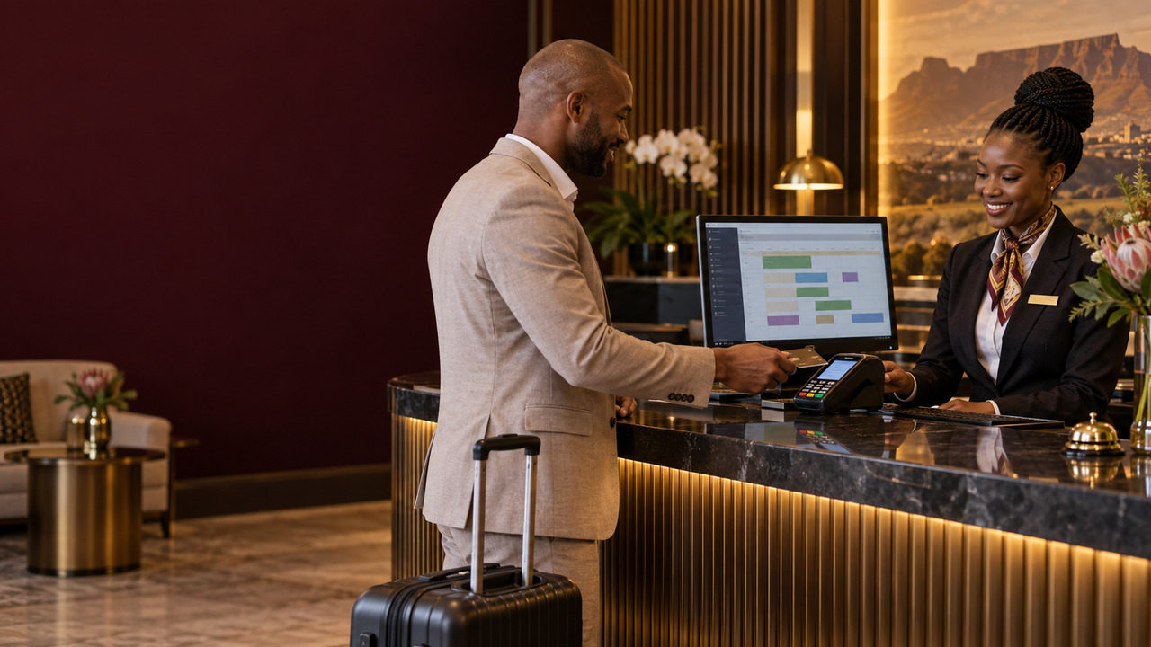


PRODUCT OVERVIEW · 2026
iVeri OPI,
Hotel payments.
Connect OPERA reservations to secure card-present payments through OPI, indiGo Cloud and the iVeri Gateway.
Sales Enablement · iVeri Payment Technologies
September 2026

Slide 2
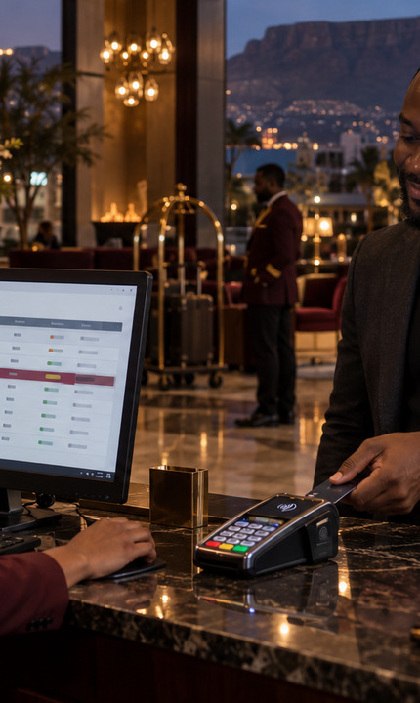


AGENDA
what we'll cover
01
What is OPI?
02
Why hotels choose it
03
Core capabilities
04
OPI at a glance
05
Payment workflow
06
Pitch and next steps
02 / 10

Slide 3
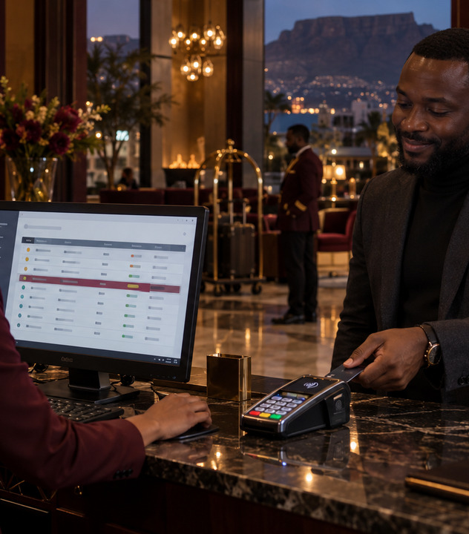
WHAT IS ORACLE PAYMENT INTERFACE?
Integrated reception payments for OPERA.
OPERA
CONNECTED
iVeri’s OPI integration connects OPERA Cloud or OPERA On-Premise v5 to card-present payments through indiGo Cloud and the iVeri Gateway.
CARD
PRESENT
Hotels can manage reservations and initiate secure payments from OPERA, improving the check-in and check-out payment experience.
“Reservations and reception payments in one connected flow.”
THE OPI VALUE
03 / 10
Notes:
Sources: https://www.iveri.co.za/oracle-payment-interface ; https://www.iveri.com/sales-hub-opi (accessed 21 September 2026).

Slide 4

02
SECTION · 02
Why
OPI
A strong fit for hotels using OPERA that want secure pay-at-reception processing linked to reservations.

Slide 5
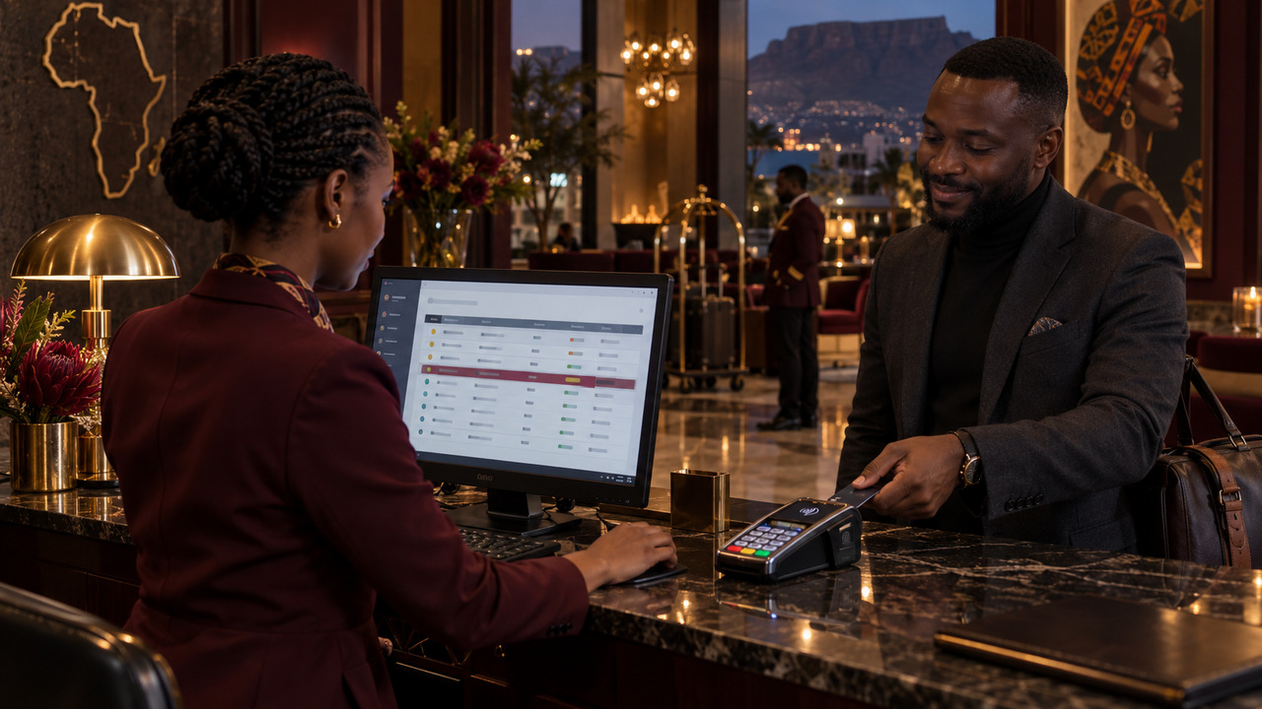
WHY HOTELS CHOOSE OPI
OPERA-connected reception payments.
01
02
03
Smoother guest payments
Unified transaction view
Secure payment handling
Initiate card-present payments from OPERA during check-in, check-out or other reception interactions.
See transactions across workstations and simplify reconciliation between payments and reservations.
Process payments over a secure channel and help reduce the hotel’s PCI DSS scope.
05 / 10
Notes:
Sources: https://www.iveri.co.za/oracle-payment-interface ; https://www.iveri.com/sales-hub-opi (accessed 21 September 2026).

Slide 6
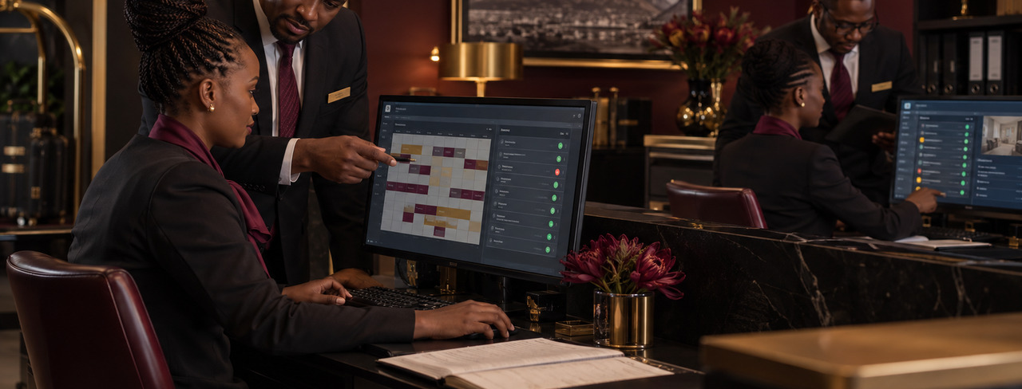
OPI AT A GLANCE
A connected payment flow for hospitality.
OPERA
CARD
SIX
ONE
CLOUD
PRESENT
TYPES
VIEW
or On-Premise v5
guest authentication
from sale to refund and void
transactions across workstations
06 / 10
Notes:
Sources: https://www.iveri.co.za/oracle-payment-interface ; https://www.iveri.com/sales-hub-opi (accessed 21 September 2026).

Slide 7
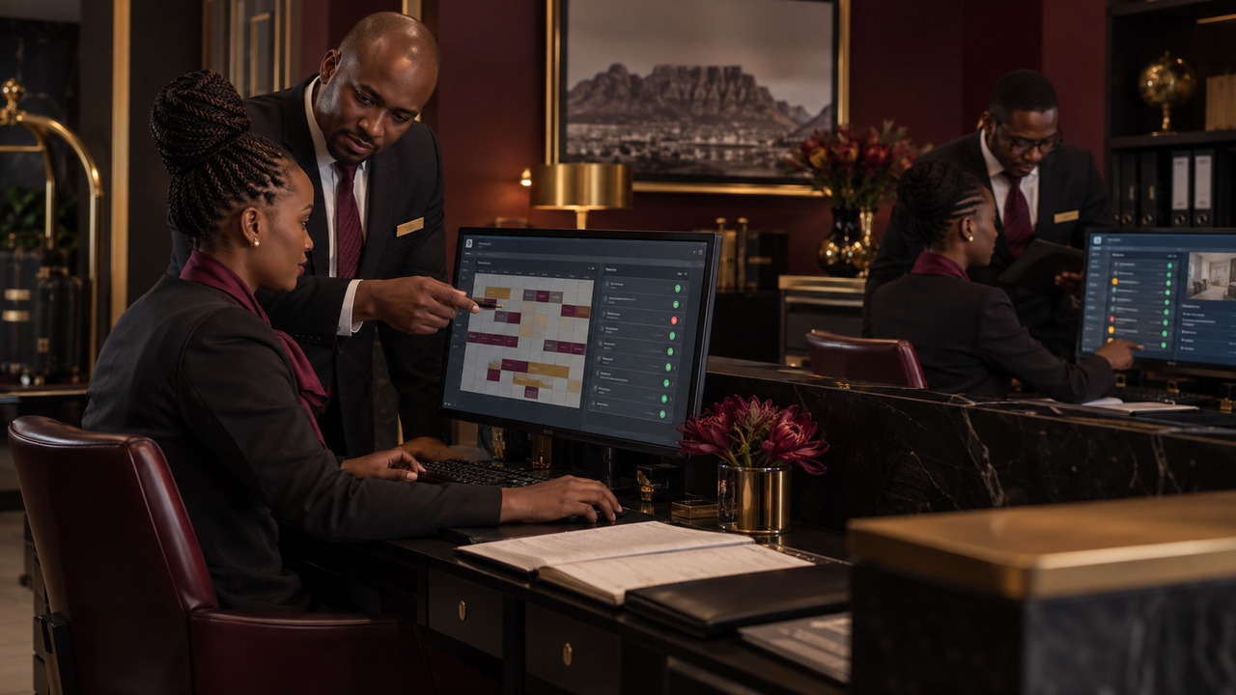

OPI PAYMENT WORKFLOW
From OPERA reservation to bank authorisation.
STEP 01
STEP 02
STEP 03
STEP 04
Initiate in OPERA
Route through OPI
Authenticate guest
Authorise & record
The hotel manages the reservation and initiates a card-present transaction from OPERA.
OPI passes the payment request to iVeri indiGo Cloud and activates the payment device.
The guest inserts, taps or dips the card and authenticates the payment on the device.
The iVeri Gateway submits the transaction to the bank and returns the result to the connected flow.
07 / 10
Notes:
Sources: https://www.iveri.co.za/oracle-payment-interface ; https://www.iveri.com/sales-hub-opi (accessed 21 September 2026).

Slide 8




THE OPI SALES PITCH
The right fit, solution and value.
01
02
03
The right fit
The solution
The value
Hotels using OPERA Cloud or OPERA On-Premise v5 that accept card-present payments at reception.
OPI connects OPERA to indiGo Cloud, the payment device, the iVeri Gateway and the acquiring bank.
Secure guest authentication, central transaction visibility and simpler reconciliation with reservations.
08 / 10
Notes:
Sources: https://www.iveri.co.za/oracle-payment-interface ; https://www.iveri.com/sales-hub-opi (accessed 21 September 2026).

Slide 9
NEXT STEPS
A practical route from hotel environment to rollout.
STEP 01
STEP 02
STEP 03
STEP 04
Discover
Plan integration
Configure & test
Pilot & launch
Confirm the OPERA version, hotel sites, workstations, payment types and current reception process.
Align the hotel, Oracle environment, acquirer and implementation partners on scope and responsibilities.
Configure the integration and test authorisation, incremental authorisation, sale, refund, settlement and void.
Pilot at selected workstations, confirm reporting and reconciliation, then roll out across the hotel.
09 / 10
Notes:
Sources: https://www.iveri.co.za/oracle-payment-interface ; https://www.iveri.com/sales-hub-opi (accessed 21 September 2026).

Slide 10
OPI Sales
OPI connects OPERA reservations with secure card-present payment processing through iVeri.
EMAIL
sales@iveri.com
PHONE
+27 11 269 4000
WEB
www.iveri.com
iVeri · payment technology

